Slide 1


Workezy
Case Study Challenge
Mohit Kiradoo
TAPMI

Slide 2

Situation and Task
Lead Generation
Brand Awareness
Marketing
Gaps
About the Company: Wokezy
Type: On demand home services
Services: Driver, Cook, Laundry Handwash, Plumber, Carpenter, Electrician, Salon,
Electronics repair, House Cleaner, Massage, Car wash and Bathroom Cleaning
Additional Services: Events (Holi, House parties etc)
Location of service: Lucknow
Booking medium: App
Media Presence: Website, App, Facebook, Instagram
SITUATION
Marginal Growth Rate is decreasing even though booking is increasing month on month.
Overall growth of the company is being obstructed by the decreased marginal growth.
Lack of awareness among the consumers.
Booking for on demand services have been decreasing marginally.
Booking for monthly services is consistent but due to worker unavailability it remains unfulfilled.
Marketing ROI is lower than expected.
Bookings are majorly dependent on cold calling and pamphlet distribution.
TASK
To increase the awareness about the brand and different services among the consumers in Lucknow
To deliver the company’s USP and Brand Message among the consumers (Target Audience correctly)
Trend analysis and demand analysis of monthly services with existing data (internal and external) to forecast demand and accommodate workers availability
To increase the marketing ROI
To reduce dependence on cold calls for sales by creating a complete sales funnel with each steps clear and result oriented.

Slide 3



Situation and Task
Lead Generation
Brand Awareness
Marketing
Gaps
Strategies for effective lead generation by tapping multiple avenues in both free and paid ways
Attractive first-time onboarding followed by referral program: This could be the best way to get the details of the leads. Offer a free sample of your services (the way uber did at the start) or offer a discounted first service like “Book your first service for free or book your first service at 50% cost”
Result: Easy customer data to follow up, Fast customer onboarding, this followed by referral bonus will help in new customer acquisition and repeat purchase
Get your first service free!!
Google my business page with google map address: The google my business page of workezy is not updated. It is one of the cheapest way for both brand awareness and lead generation. By updating the google my business page with company address, photos, services details, keywords and reviews you will receive queries which could be followed up for conversion
Result: Free lead generation, Ranking in google without paying, easy to find, reviews will help in trust building
Google My Business
Need Survey by college interns/Ambassadors: This is again one of the cheapest ways of getting data. Hire interns from local colleges as ambassadors (just like Tinder, Red bull do) and prepare a google form with relevant questions to identify what is the need of your business in Lucknow and what are the customer pain points.
Result: This will help in 2 ways. First, free data to follow-up. Second, insights of consumer behaviour.
College Ambassador Program

Slide 4



Situation and Task
Lead Generation
Brand Awareness
Marketing
Gaps
Strategies for effective Brand Awareness by tapping different avenues in both free and paid ways
Instagram Reels with Pain Points and Stories: As observed the Reels frequency on Workezy’s Instagram page is very low (Last reel was uploaded 2 week back). Uploading frequent Instagram reels with subjects like customer pain points, user stories, services demo with trendy music and Lucknow hashtags is at present the cheapest way to increase brand awareness
Result: Increase in brand awareness, high chances of going viral, the paid version of this could be collaboration with local influencers for reels promotion
Use cases and Story Telling on reels
PPC ads with relevant keywords: The relevant keywords and google searches for Workezy could be “Home services in Lucknow”, “ Drivers to hire in Lucknow”, “Electronics repair at home” etc as observed, presence of Workezy on these keywords is very low. Either you could hire in house digital marketing interns or can outsource with any agency. Initially it will be costly but much needed. Also listing on websites like Justdial and Sulekha is a must do
Result: Ranking on google search, Rich leads and boost in brand awareness
Targeted PPC Ads
Pamphlets and Paper inserts with minimum words Ad Copy and Scratch offer: Pamphlets and Paper inserts are useful but impossible to track ROI and too much crowded. Two best ways to make the most out of these are 1) Minimum words (8-10) Ad Copy (To attract) 2) Scratch offer (To convert and track).
Result: This will enable ROI tracking for these activities and also increase brand awareness by placing these pamphlets and inserts in potential catchments (IT Parks, Bachelors Appartements, Nuclear Family areas, Malls, Theatres etc)
Modern Pamphlets and Inserts

Slide 5



Situation and Task
Lead Generation
Brand Awareness
Marketing
Gaps
Strategies for effective Marketing and Promotion by tapping different avenues in both free and paid ways
Email Marketing: Customized email marketing pushing the on demand services with seasonal trends (Free tool – HubSpot free email marketing tool). (Note: The Email Copy should be sharply targeted and to the point)
Result: Increase in brand awareness, High chances of conversion with Call to action, Tracking.
Email Marketing
YouTube and Blog Promotion: This is one of the easiest way to reach mass in the local region. Collaboration with Lucknow based popular youtubers and bloggers having a wide reach.
Result: Wider reach, brand awareness and long term presence
Local YouTube Channels and Blogs
Sponsoring local college events: College events sponsorships acts as a barter system. Workezy can do these college sponsorships for these activities like – App downloads, App reviews, Surveys for data and insights, Kiosks at colleges etc
Result: Wider reach, brand promotion and word of mouth.
College event sponsorships

Slide 6

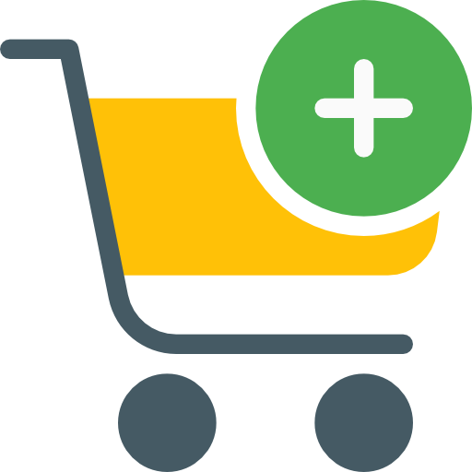


Situation and Task
Lead Generation
Brand Awareness
Marketing
Gaps
Potential GAPS and their solutions
Gaps | Solutions
Less reviews on Google App and no response from Workezy | Play Store reviews are one of the drivers of app installation. Workezy need to increase the reviews on Play Store by encouraging users to share feedback and responding the reviews on time
No option for booking through website. Users don’t readily install the app and bookings only through app restricts the inbound | Booking feature (Add to cart) to be enabled on Website. This will also help in retargeting on social media. For example: If a user added driver service in cart but did not checkout then we can retarget him/her on social media for the same service
No Loyalty Program. A point-based loyalty program helps in user retention | A point-based in app loyalty program based on earn and burn model.
No Cross Selling on App. Cross selling of complimentary services increase the basket size and ultimately the revenue | Introducing combos or packages with complimentary services like (Haircut + Shaving + Massage) with attractive offers

Slide 7
Cost and Revenue Structure
Cost and Revenue Structure_Mohit Kiradoo_TAPMI.docx

Slide 8
Thank You!
LinkedIn - https://www.linkedin.com/in/mohitkiradoo/

